Slide 1
Platform Drivers

Slide 2
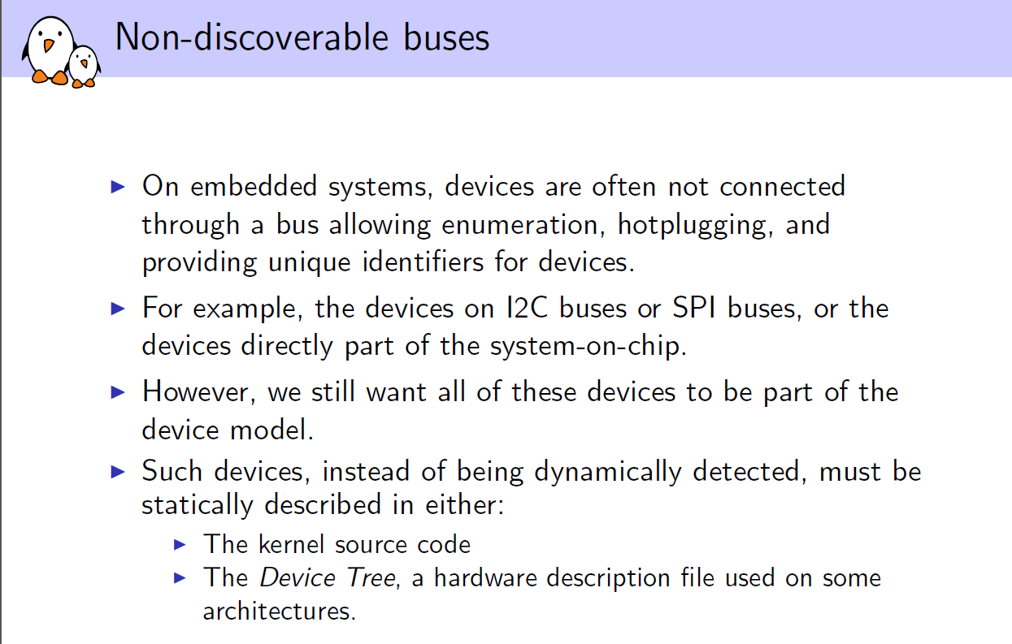
X86: ls /sys/firmware/acpi/tables
acpidump > acpi.dat
iasl -d acpi.dat

Slide 3
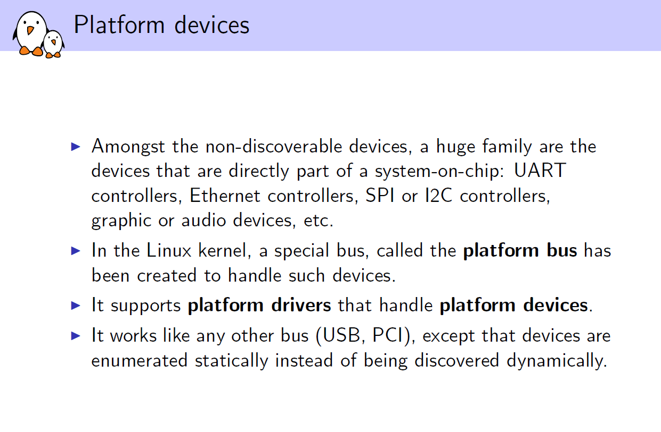
Platform devices are often used to represent the variety of devices on a System on Chip (SoC) within an embedded board. The SoC is typically a very sophisticated chip that integrates various components into its silicon. Besides processing units (CPUs/GPUs), it might house several peripherals too, including Ethernet MAC, USB, multimedia, serial UART, clock, I2C, SPI, flash chip controllers, and so on. A reason we need these components to be enumerated as a platform device is that there is no physical bus within the SoC; thus, the platform bus is used.

Slide 4
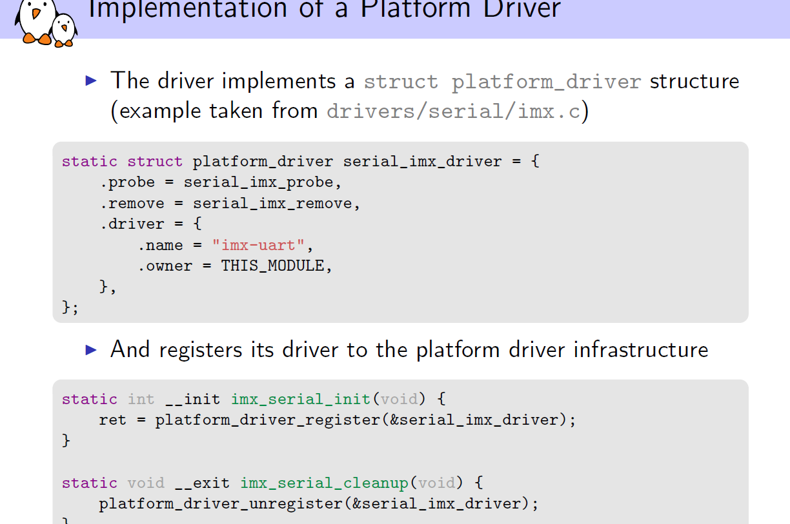

Slide 5
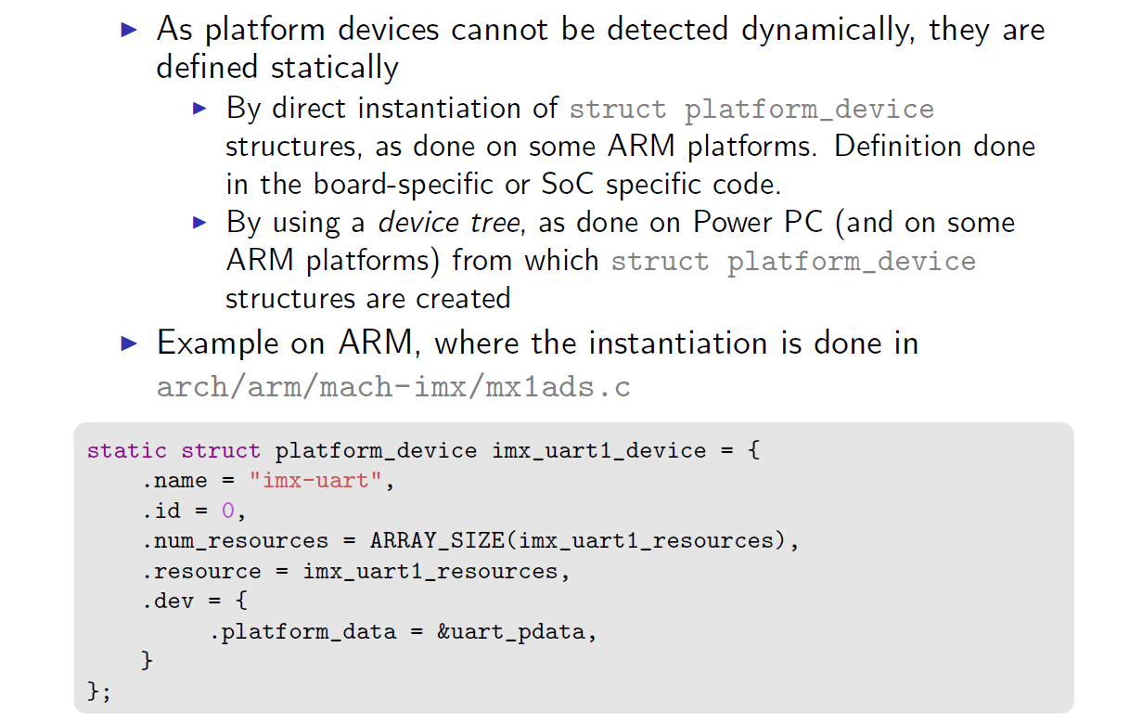

Slide 6
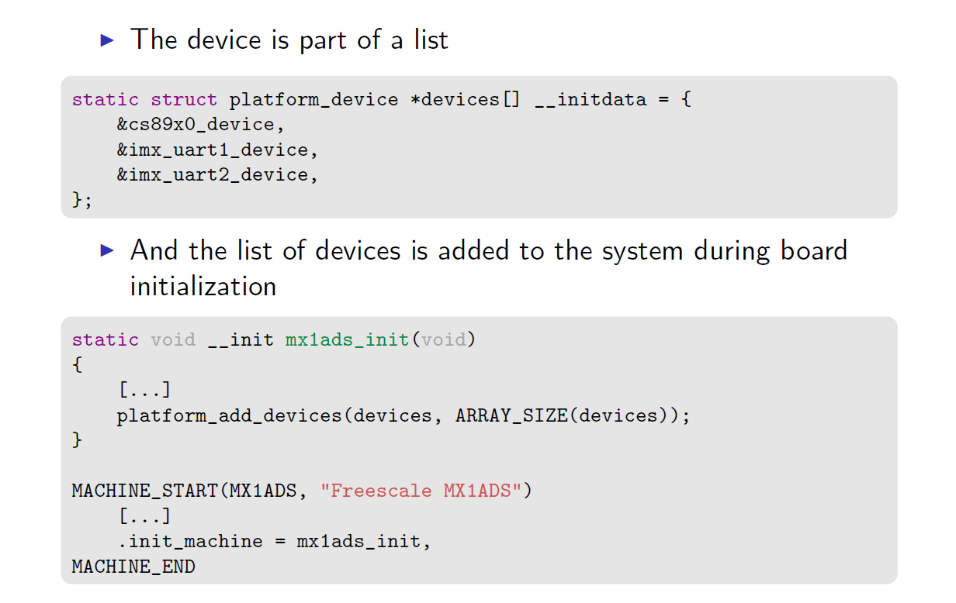

Slide 7
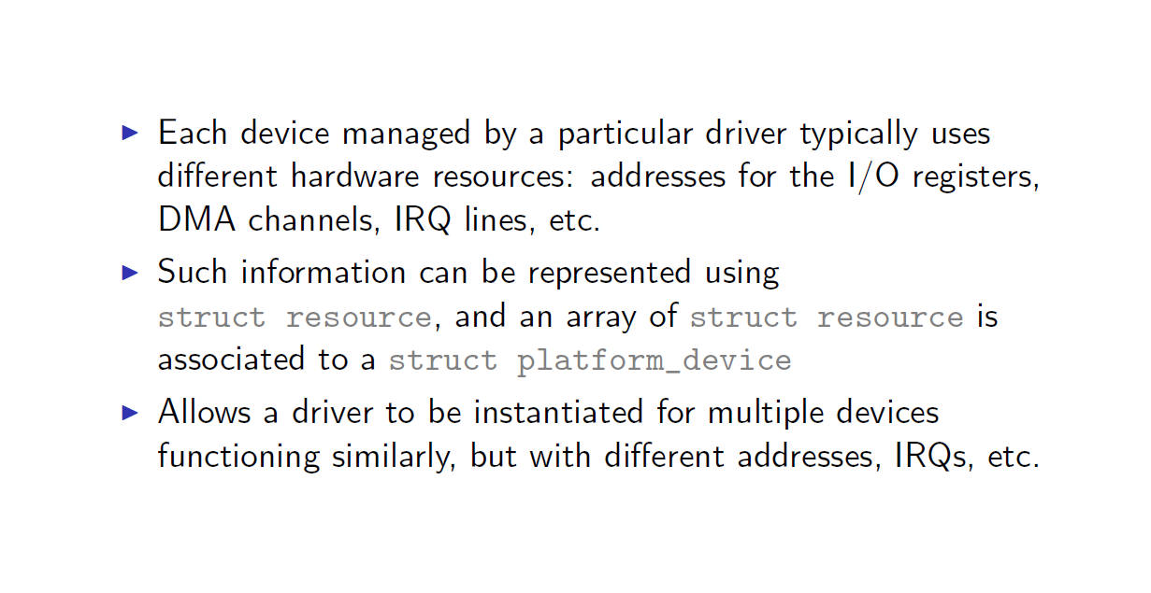

Slide 8
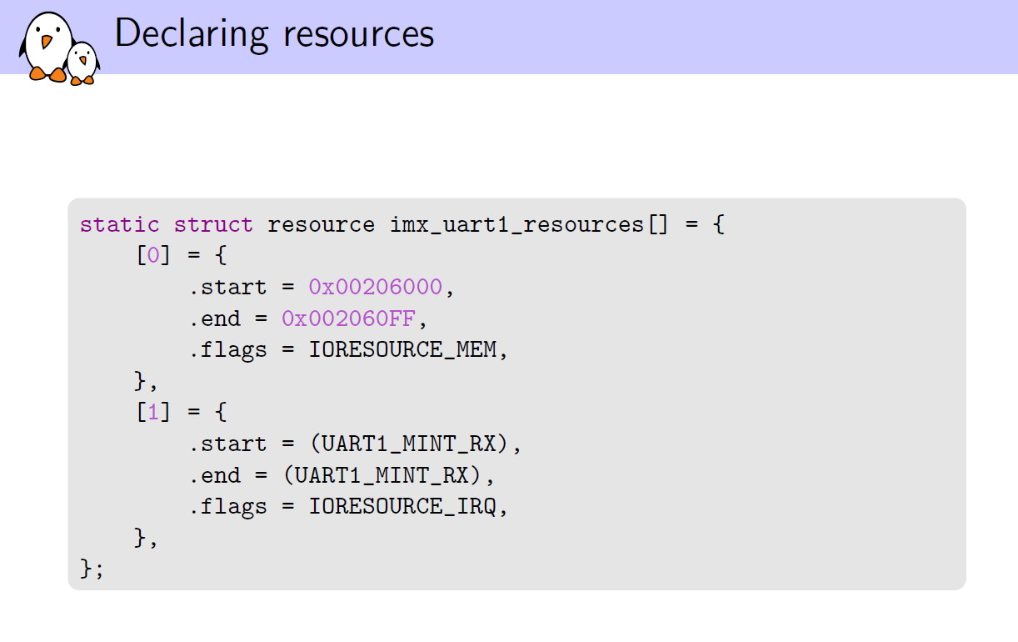

Slide 9
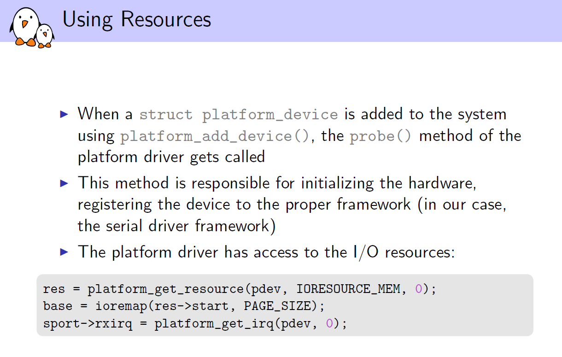

Slide 10
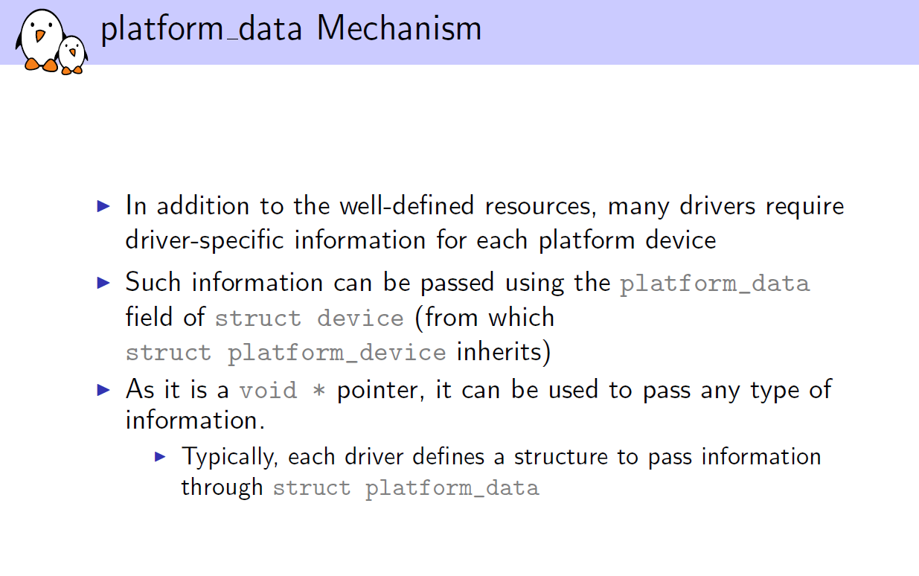

Slide 11
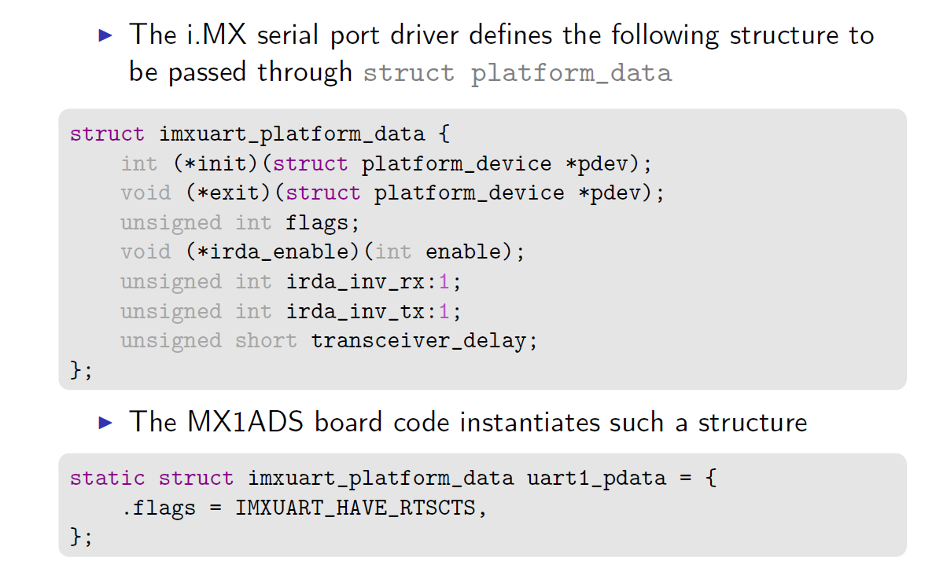

Slide 12
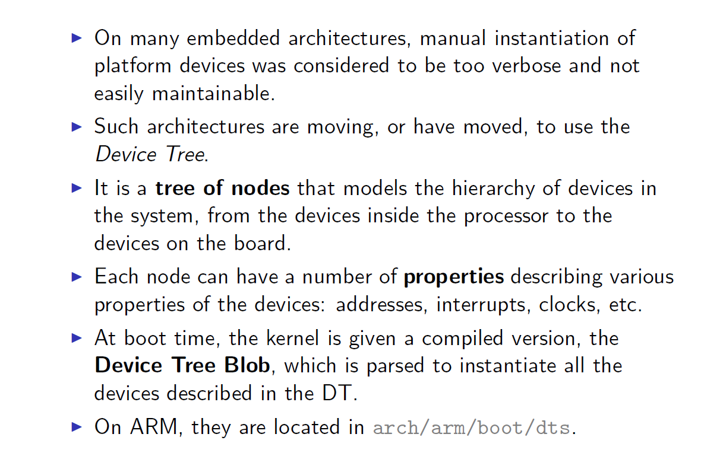
Device Tree:
Using ACPI tables
▶ On x86 systems, but also on a subset of ARM64 platforms
▶ Tables provided by the firmware

Slide 13
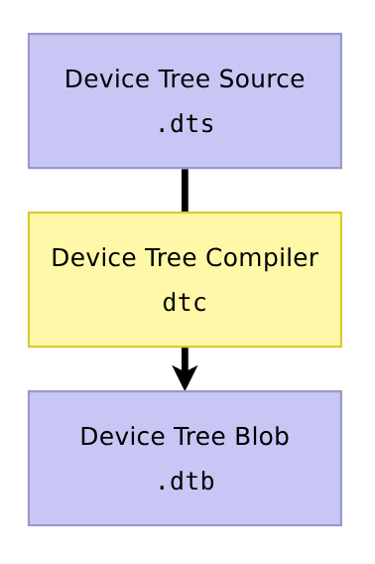
Device Tree: from source to blob
▶ A tree data structure describing the
hardware is written by a developer in a
Device Tree Source file, .dts
▶ Processed by the
Device Tree Compiler, dtc
▶ Produces a more efficient representation:
Device Tree Blob, .dtb
▶ Additional C preprocessor pass
▶ .dtb → accurately describes the
hardware platform in an OS-agnostic way.
▶ .dtb ≈ few dozens of kilobytes
▶ DTB also called FDT,
Flattened Device Tree, once
loaded into memory.
• fdt command in U-Boot
• fdt_ APIs

Slide 14
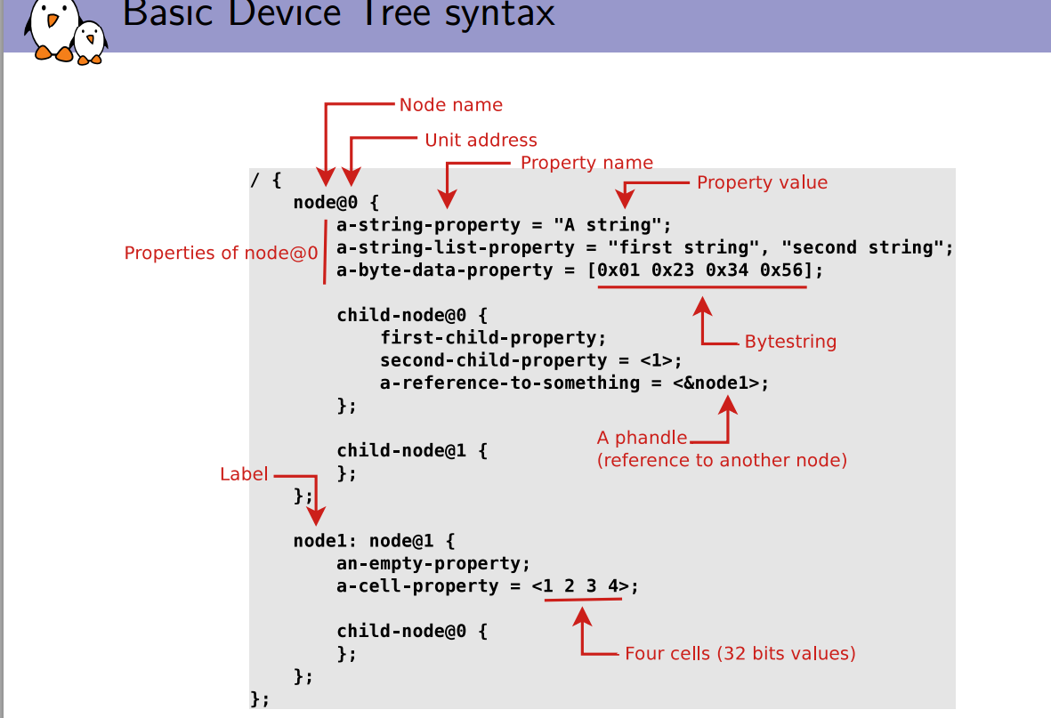

Slide 15
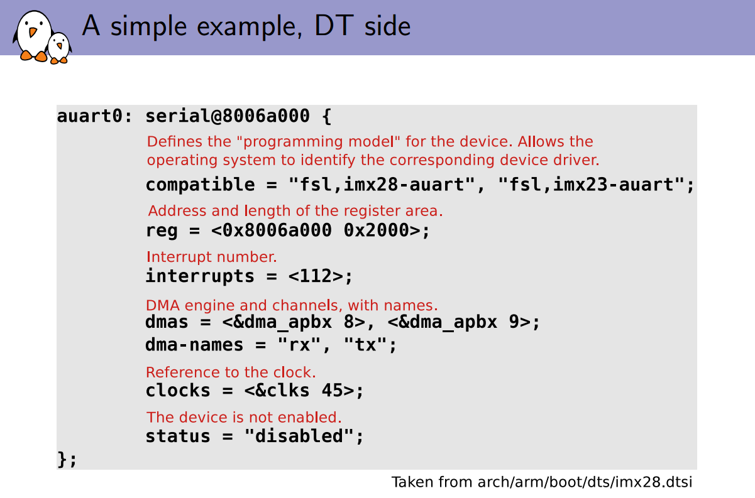

Slide 16
#address-cells: Indicates the number of cells used to carry the address
#size-cells: Indicates the number of cells used to carry the size of the range
dts/ {
#address-cells = <1>;
#size-cells = <1>;
serial@101f1000 {
compatible = "arm,pl011";
/* Base Address = 0x101f1000 (1 cell), Size = 0x1000 (1 cell) */
reg = <0x101f1000 0x1000>;
};
};
/ {
#address-cells = <2>;
#size-cells = <2>;
serial@0 0x90000000 {
compatible = "ns16550a";
/* Base Address = 0x00000000 90000000 (2 cells) */
/* Size = 0x00000000 00001000 (2 cells) */
reg = <0x0 0x90000000 0x0 0x1000>;
};
};

Slide 17
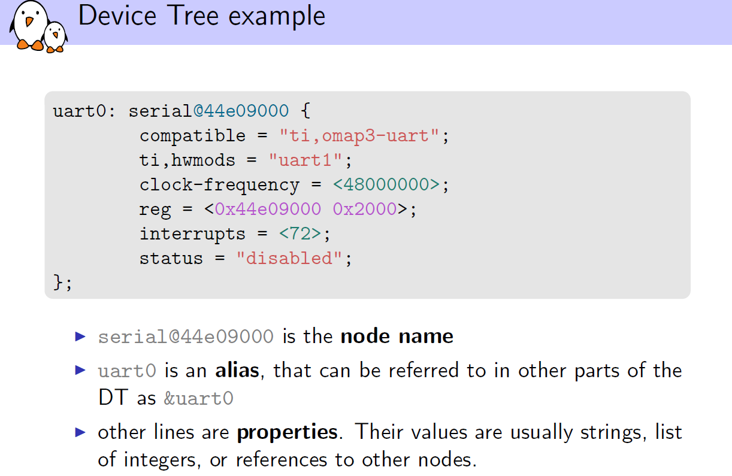

Slide 18
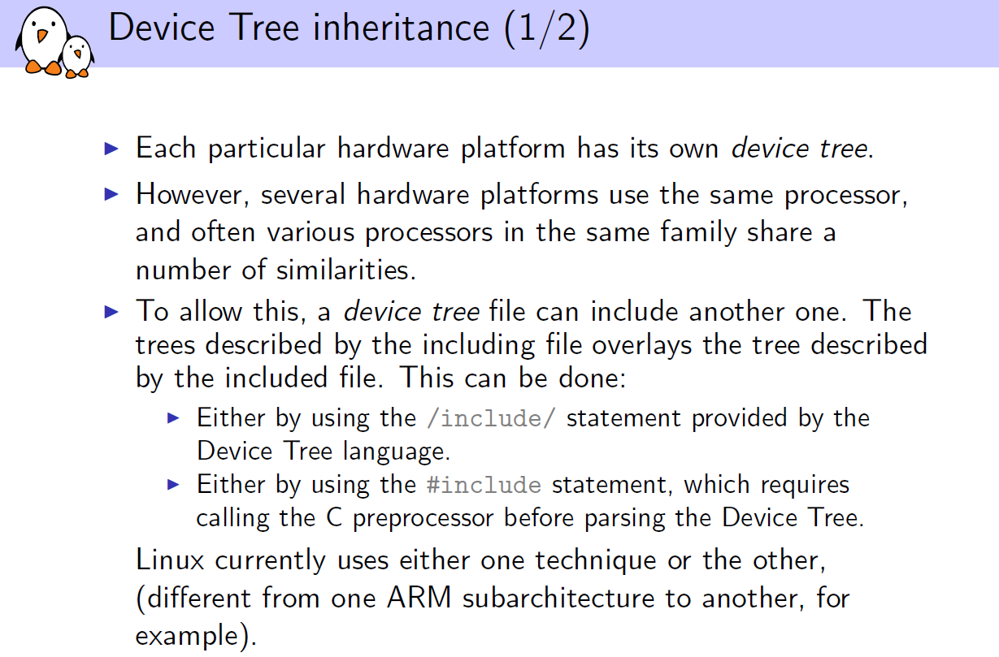

Slide 19
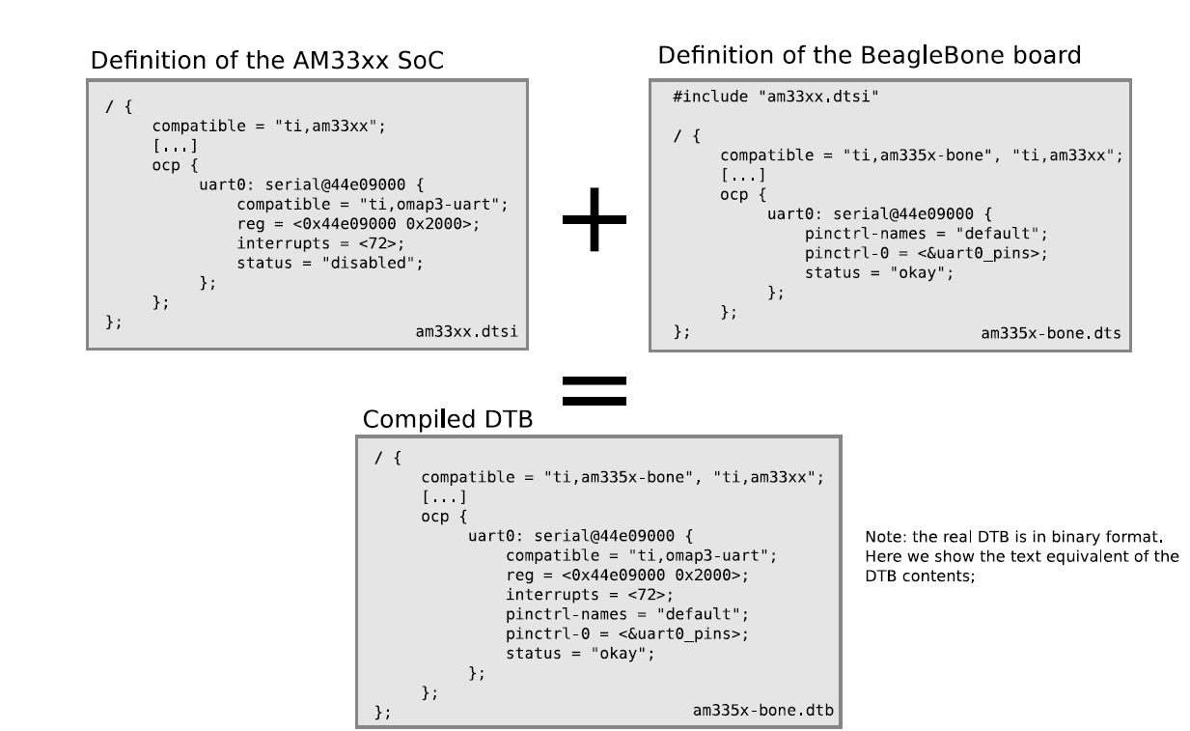
Device Tree Inheritance:

Slide 20
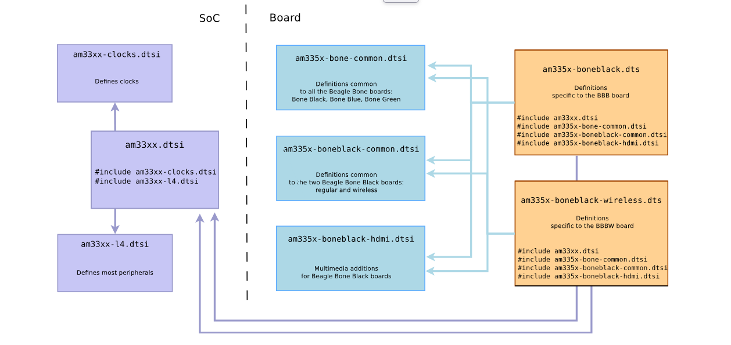
DT inheritance in Bone Black support
Explore DT inheritance in Raspberry PI

Slide 21
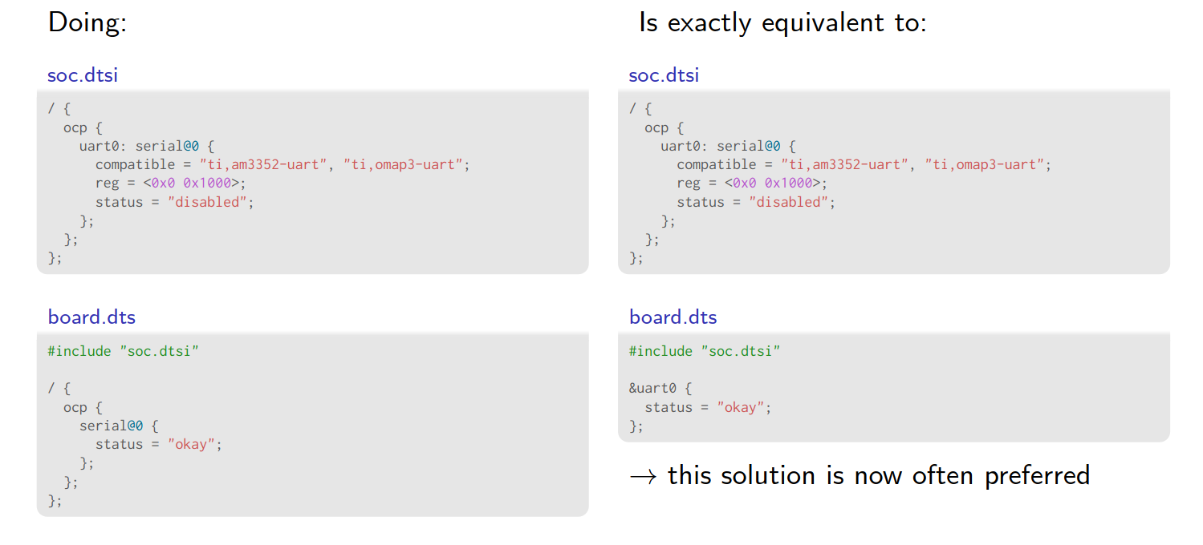
Activity:
Explore Device tree Inheritance on Raspberry PI platform files

Slide 22
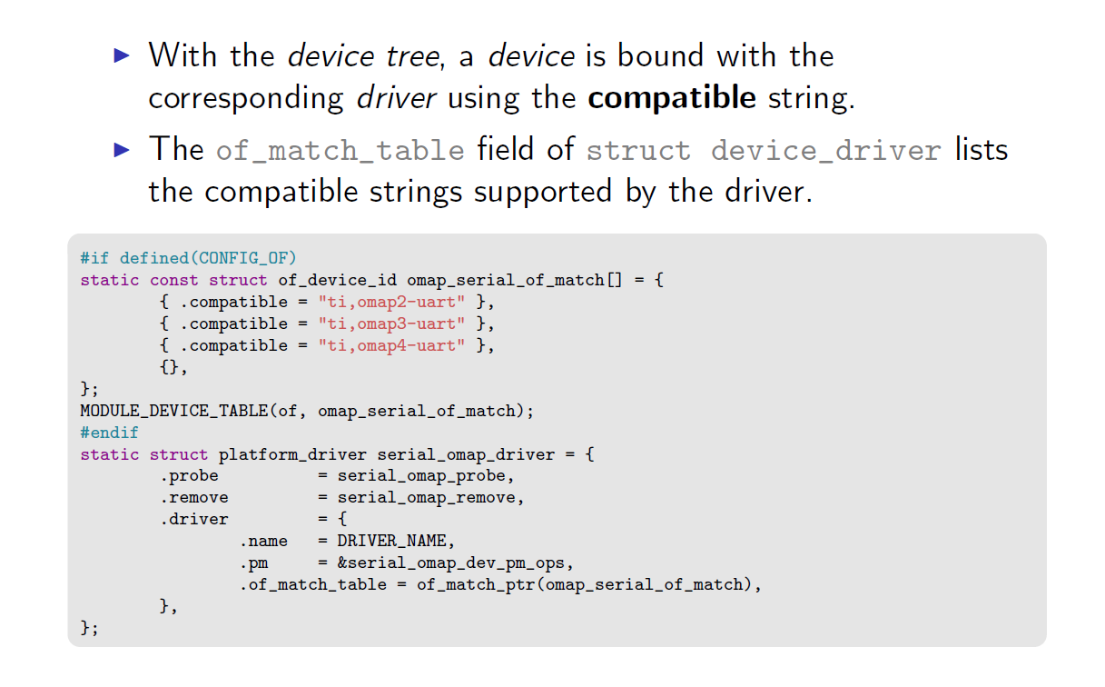
https://elixir.bootlin.com/linux/v6.5/source/drivers/net/ethernet/xilinx/xilinx_axienet_main.c

Slide 23
Device Tree is a special way of encoding all the information about the hardware attached to a system (and consequently required drivers). On a Raspberry Pi or Compute Module there are several files in the first FAT partition of the SD/eMMC that are binary 'Device Tree' files. These binary files (usually with extension .dtb) are compiled from human-readable text descriptions (usually files with extension .dts) by the Device Tree compiler. By default, the Raspberry Pi kernel boots with device tree enabled. You can completely disable DT usage (for now) by adding: device_tree=
On a standard Raspberry Pi OS image in the first (FAT) partition you will find two different types of device tree files, one is used by the GPU only and the rest are standard ARM device tree files for each of the BCM283x based Raspberry Pi products:
bcm2710-rpi-3-b.dtb (Used for Raspberry Pi 3 Model B) bcm2710-rpi-4-b.dtb (Used for Raspberry Pi 4 Model )
During boot, the user can specify a specific ARM device tree to use via the device_tree parameter in config.txt, for example adding the line device_tree=mydt.dtb to config.txt where mydt.dtb is the dtb file to load instead of one of the standard ARM dtb files.
In addition to loading an ARM dtb, start.elf supports loading additional Device Tree 'overlays' via the dtoverlay parameter in config.txt, for example adding as many dtoverlay=myoverlay lines as required as overlays to config.txt, noting that overlays live in /overlays and are suffixed -overlay.dtb e.g. /overlays/myoverlay-overlay.dtb. Overlays are merged with the base dtb file before the data is passed to the Linux kernel when it starts.
Device Tree Source and Compilation The Raspberry Pi OS image provides compiled dtb files, but where are the source dts files? They live in the Raspberry Pi Linux kernel branch, on GitHub. Look in the arch/arm/boot/dts folder. Some default overlay dts files live in arch/arm/boot/dts/overlays. Corresponding overlays for standard hardware that can be attached to a Raspberry Pi in the Raspberry Pi OS image are on the FAT partition in the /overlays directory.
sudo apt install device-tree-compiler
sudo dtc -@ -I dts -O dtb -o /boot/overlays/example1.dtbo /boot/example1-overlay.dts
The '-@' in theÂ dtcÂ command line. This is necessary if you are compiling dts files with external references, as overlays tend to be.
Activity: Add new dts node to existing Raspberry PI device tree with DTS overlay.

